Slide 1
Activity 1
Kinematic simulation of a nonholonomic robot

Slide 2
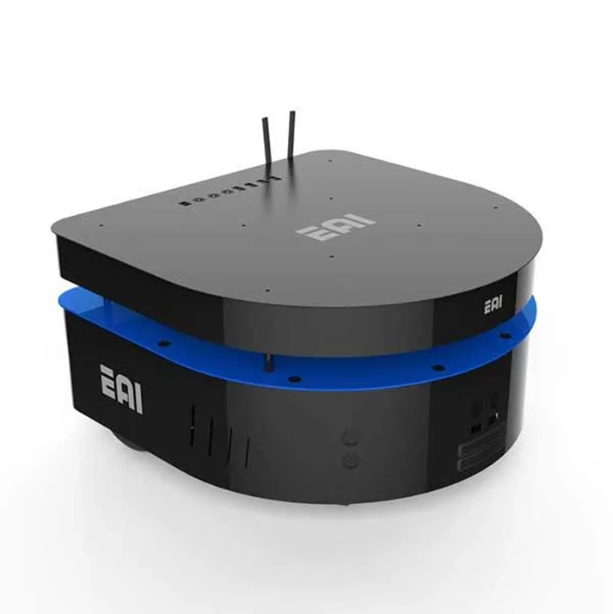
Introduction
This activity is intended for the student to review the concepts introduced in this week.
Development of a kinematic simulator for the EAI DashGo B1 robotic platform using the kinematic model of a nonholonomic robot.

Slide 3
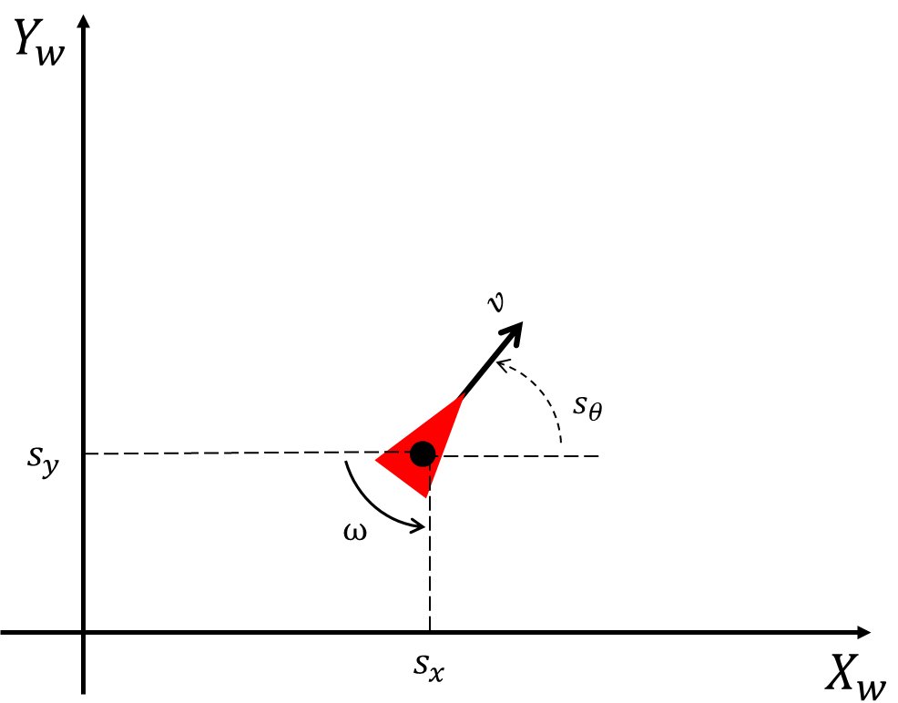

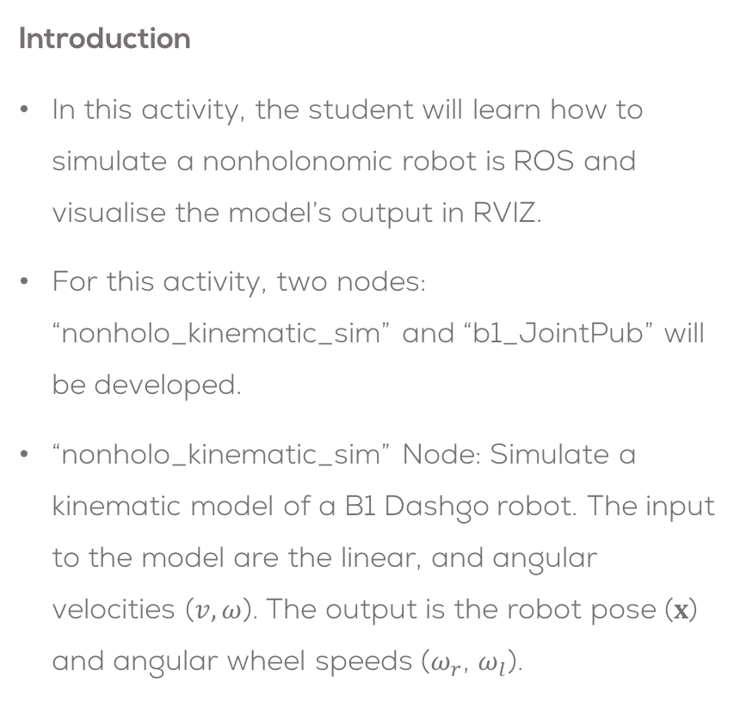


Introduction
Introduction
In this activity, the student will learn how to simulate a nonholonomic robot is ROS and visualise the model’s output in RVIZ.
For this activity, two nodes: “nonholo_kinematic_sim” and “b1_JointPub” will be developed.
“nonholo_kinematic_sim” Node: Simulate a kinematic model of a B1 Dashgo robot. The input to the model are the linear, and angular velocities ($v, ω$). The output is the robot pose ($x$) and angular wheel speeds ($ω_{r}$, $ω_{l}$).
nonholo_kinematic_sim
$$x$$
$v, ω$
$$ω_{r}\text{, }ω_{l}$$

Slide 4
Activity 1
Download the package called “dashgo_b1”, from the folder “/Week4/Activity1/” to your “catkin_ws”
Do not forget to give executable permission to the file
cd ~/catkin_ws/src/dashgo_b1/scripts/
sudo chmod +x nonholo_kinematic_sim.py
sudo chmod +x b1_JointPub.py
Verify that the CMake file includes both scripts (line 168)
catkin_install_python(PROGRAMS scripts/nonholo_kinematic_sim.py scripts/b1_JointPub.py
DESTINATION ${CATKIN_PACKAGE_BIN_DESTINATION})
Compile the package
cd ~/catkin_ws/
catkin_make
Launch the file
roslaunch dashgo_b1 b1_robot.launch
Verify that the model can be visualised in RVIZ and the Joints can be actuated using the Joint State Publisher GUI
Set fixed frame in RVIZ to be “base_link”

Slide 5
What is included in the “dashgo_b1” Package
The student is given a URDF file and STL models, describing the DashGo B1 Robot.
“urdf” and “models” folders
The student is provided with a script template “nonholo_kinematic_sim” to develop the robot’s kinematic model.
Located inside the scripts folder.
The student is provided with a premade node script “b1_JointPub.py” to publish the joint states of the robot’s wheels (more information in the following slides).
Predefined launch files for easier configuration and testing.

Slide 6




Activity 1
/joint_states
$$x$$
B1_JointPub
robot_state_publisher
/tf
$v, ω$
nonholo_kinematic_sim
$$ω_{r}\text{, }ω_{l}$$
RVIZ
URDF
File
.STL Files

Slide 7
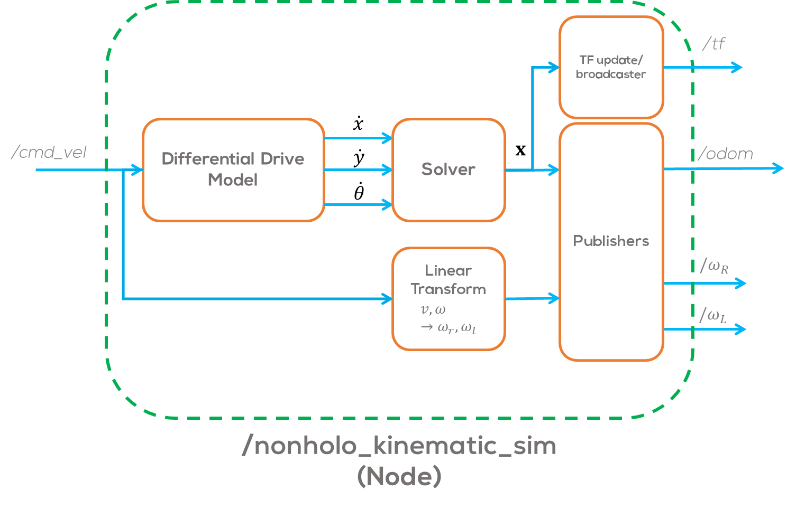
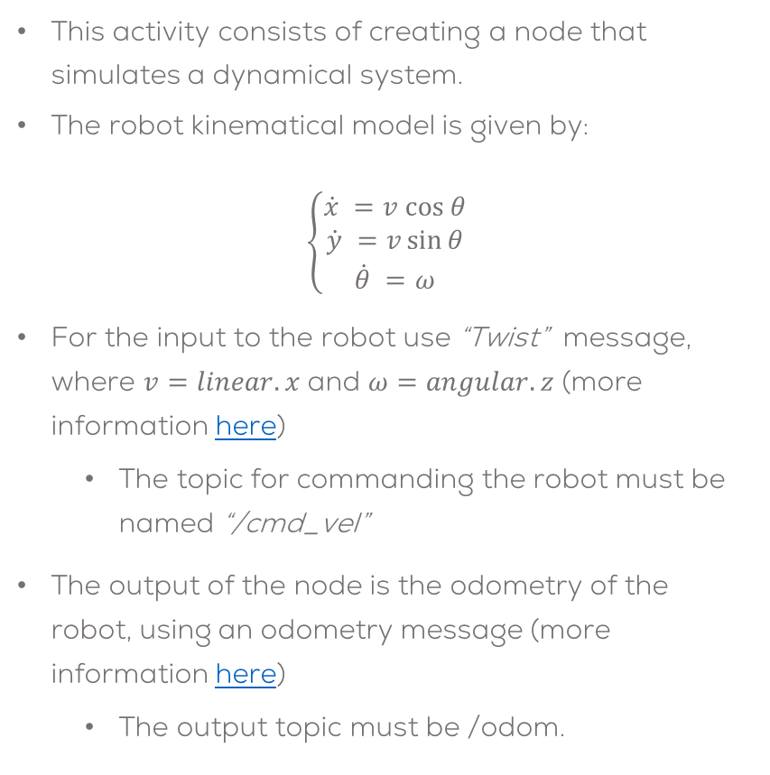
Activity 1
This activity consists of creating a node that simulates a dynamical system.
The robot kinematical model is given by:
$$\left\{\begin{aligned}\dot{x} =v cos θ \\ \dot{y} =v\sin{θ} \\ \dot{θ} =ω\end{aligned}\right.$$
For the input to the robot use “Twist” message, where $v=linear.x$ and $ω=angular.z$ (more information here)
The topic for commanding the robot must be named “/cmd_vel”
The output of the node is the odometry of the robot, using an odometry message (more information here)
The output topic must be /odom.

Slide 8
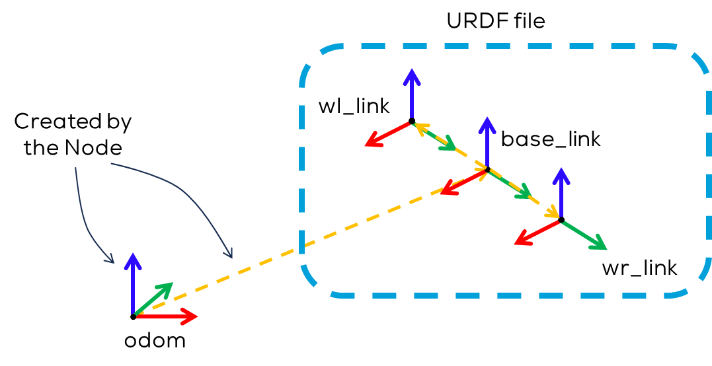
Activity 1
The node must create an “odom” link using transforms.
The node must output a transformation between the “odom” frame and the “base_link” frame (defined in the URDF file) this is a 2 DOF transform, not possible with URDF.
Create it using the tf2 transformation and transform broadcaster.

Slide 9
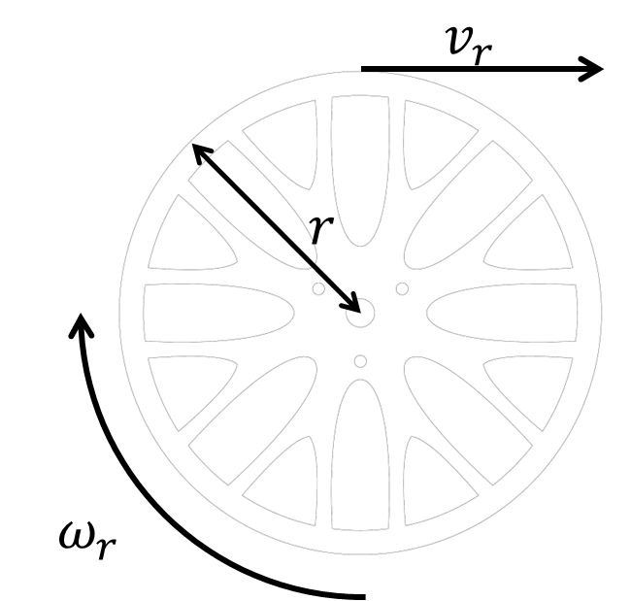

Activity 1
The wheel speed must also be published using a “Float 32” std_msg.
The topics for each wheel must be “/wr” and “/wl”, for the left and right wheels respectively.
$Remember$:
$$v=\frac{v_{R}+v_{L}}{2}=r\frac{ω_{R}+ω_{L}}{2} \\ ω=\frac{v_{R}−v_{L}}{l}=r\frac{ ω_{R}−ω_{L}}{l}$$
#Robot Parameters
r = 0.062
l = 0.33

Slide 10
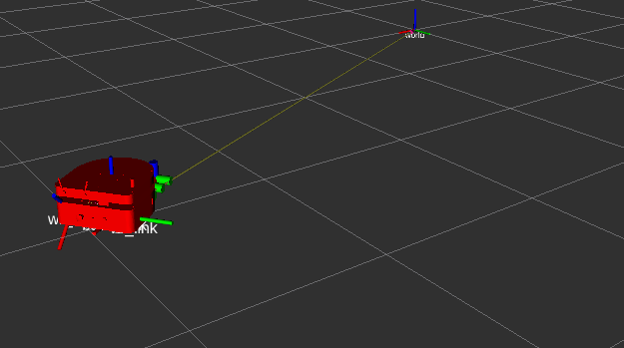
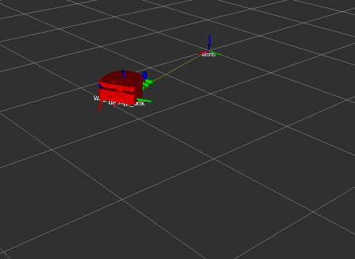
Activity 1
The student is allowed to use “tf” coordinate transforms or “URDF “ files for the simulation, or a combination of both.
The student must define the coordinate frames and transformations to be used.
The students must define the required launch files for this activity.
The simulation must be tested under different conditions, i.e., different speeds.
The students must define a correct sampling time for the simulation .
The students must solve the differential equations using numerical methods.
The usage of any library is strictly forbidden.
Expected results:

Slide 11
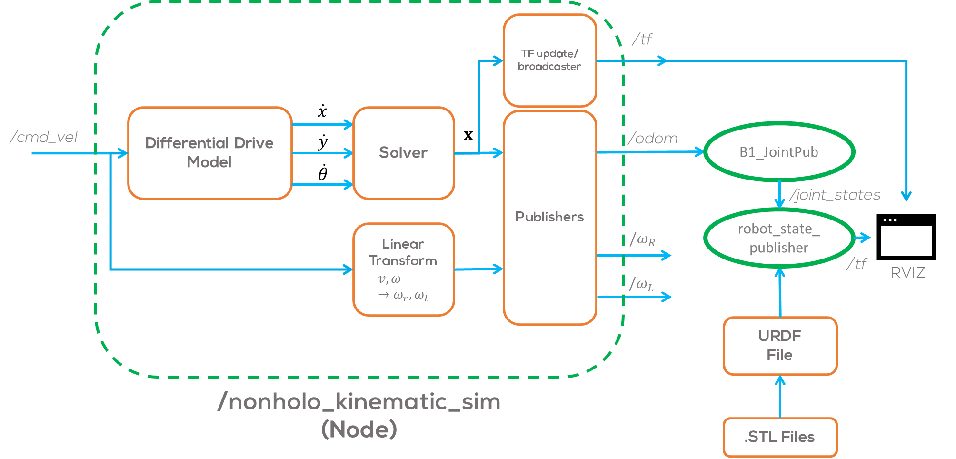
Activity 1

Slide 12

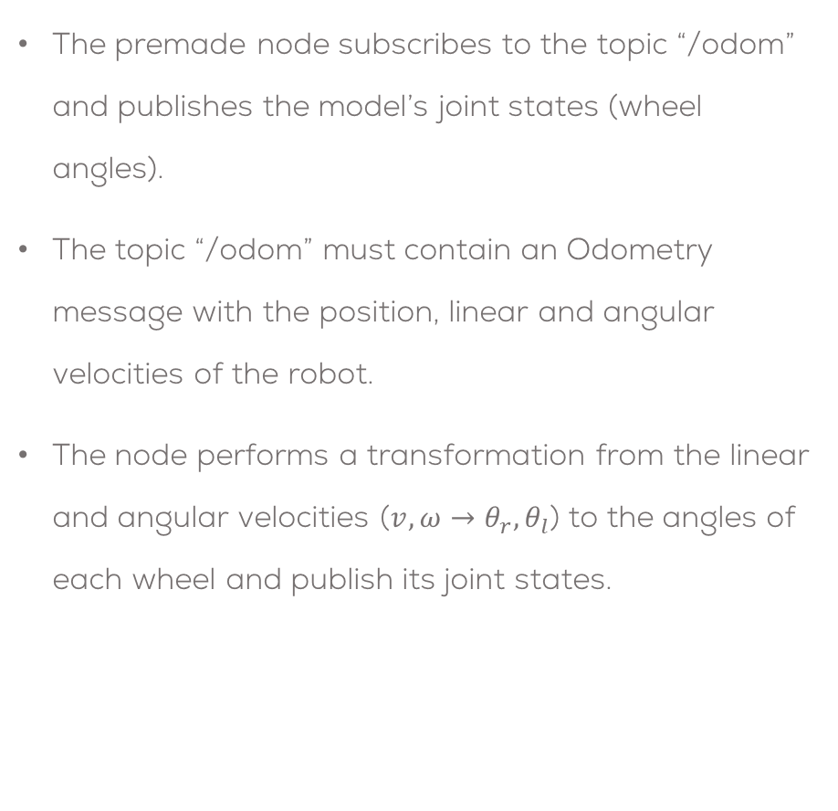


B1_JointPub node
The premade node subscribes to the topic “/odom” and publishes the model’s joint states (wheel angles).
The topic “/odom” must contain an Odometry message with the position, linear and angular velocities of the robot.
The node performs a transformation from the linear and angular velocities ($v,ω→θ_{r}, θ_{l}$) to the angles of each wheel and publish its joint states.
/odom
B1_JointPub
/joint_states
$$v,ω→θ_{r}, θ_{l}$$
“rightWheel“
"leftWheel"
robot_odom.header.frame_id = "odom"
robot_odom.header.stamp = rospy.Time.now()
robot_odom.child_frame_id = "base_link"
robot_odom.pose.pose.position.x = pos_x
robot_odom.pose.pose.position.y = pos_y
robot_odom.pose.pose.position.z = 0.0
robot_odom.pose.pose.orientation.x = pos_orient[0]
robot_odom.pose.pose.orientation.y = pos_orient[1]
robot_odom.pose.pose.orientation.z = pos_orient[2]
robot_odom.pose.pose.orientation.w = pos_orient[3]
robot_odom.pose.covariance = [0]*36
robot_odom.twist.twist.linear.x = 0.0
robot_odom.twist.twist.linear.y = 0.0
robot_odom.twist.twist.linear.z = 0.0
robot_odom.twist.twist.angular.x = 0.0
robot_odom.twist.twist.angular.y = 0.0
robot_odom.twist.twist.angular.z = 0.0
robot_odom.twist.covariance = [0]*36
$$v$$
$$ω$$

Slide 13
Activity
Part 2: Testing the model

Slide 14
Activity 1
Download the “teleop” node
sudo apt install ros-noetic-teleop-twist-keyboard
Open the launch file “b1_robot.launch” .
Comment the joint state publisher (line 12).
Uncomment the rest of the lines in the launch file (except the comments!)
Launch the file
Control the robot using the keyboard

